Slide 1
Facebook and Instagram performance Dashboard

Slide 2
Objective of the Analysis
To measure overall social media performance.
To analyze engagement, impressions, and CTR.
To compare Facebook vs Instagram.
To identify best performing content types.
To support data-driven marketing decisions.

Slide 3




Key Performance Indicators (KPIs)
These KPIs help evaluate reach, interaction, and effectiveness of posts.
Total Impressions: 3 Million
Engagement Rate: 1
Click Through Rate (CTR): 1.69
Total Engagement: 45K

Slide 4
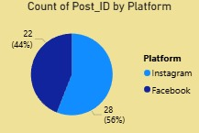
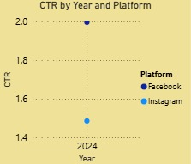

Platform-wise Post Distribution
Instagram: 28 posts (≈56%)
Facebook: 22 posts (≈44%)
Instagram has slightly higher posting activity compared to Facebook.

Slide 5
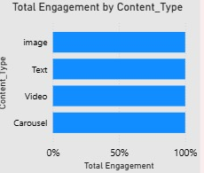
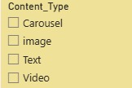
Engagement by Content Type
Content types analyzed:
Image
Text
Video
Carousel
Observation:
Image and Video content show higher engagement
Text content has relatively lower interaction
Carousel posts maintain consistent engagement

Slide 6
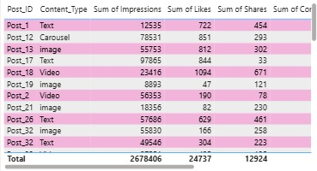
Impressions & Engagement Analysis
Total Impressions: 2,678,406
Total Likes: 24,737
Total Shares: 12,924
High impressions indicate strong visibility, while likes and shares show audience interest.

Slide 7
Click Through Rate (CTR) Analysis
CTR Value: 1.69%
CTR Meaning:
Percentage of users who clicked after seeing the post.
Indicates effectiveness of content + call-to-action.
CTR of 1.69% shows moderate audience response and scope for optimization.

Slide 8
Insights & Findings
Instagram contributes more to engagement.
Image and video posts perform better than text posts.
High impressions but comparatively lower CTR.
Content is visible but can be improved for clicks.

Slide 9
Recommendations
Focus more on image & video-based content.
Improve call-to-action (CTA) to increase CTR.
Optimize posting strategy on Instagram.
Test different captions and creatives.
Use carousel posts for storytelling and promotions.

Slide 10
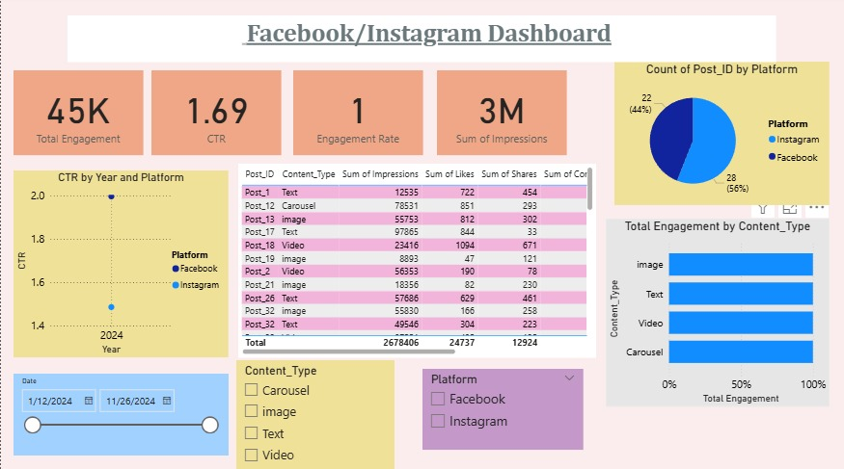
Conclusion
The dashboard provides a clear view of social media performance.
Instagram is the stronger engagement platform.
Visual content drives better results.
Data insights can help improve future marketing strategies.

